Slide 1


Dan Smart , Derek Shashek, Minette James and Suzanne Polk

Slide 2
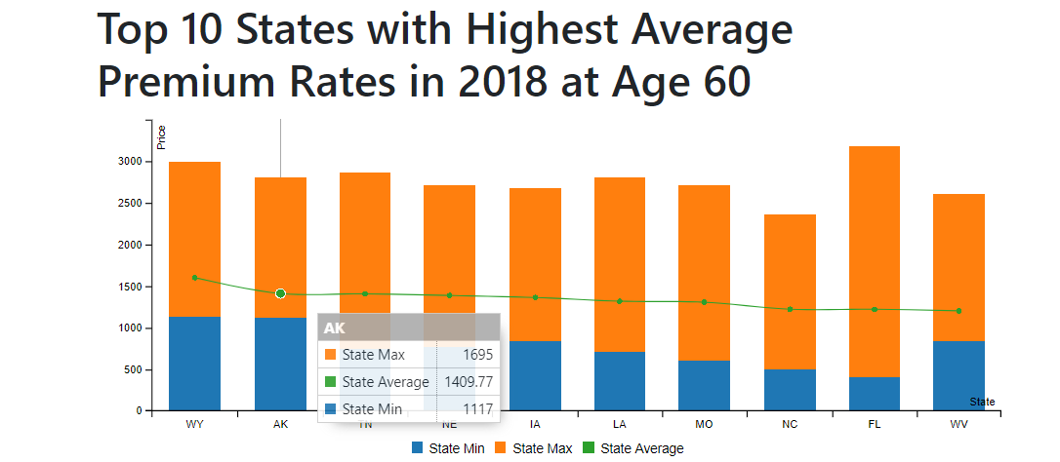
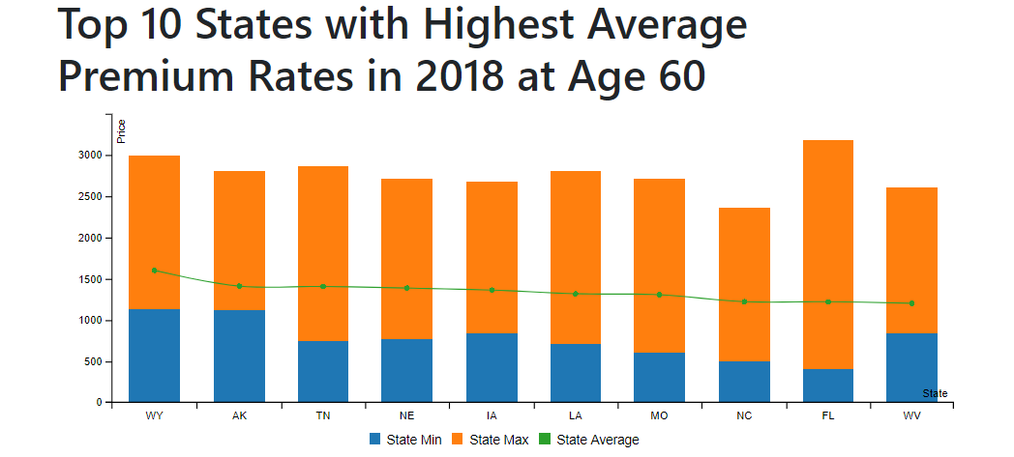


Slide 3
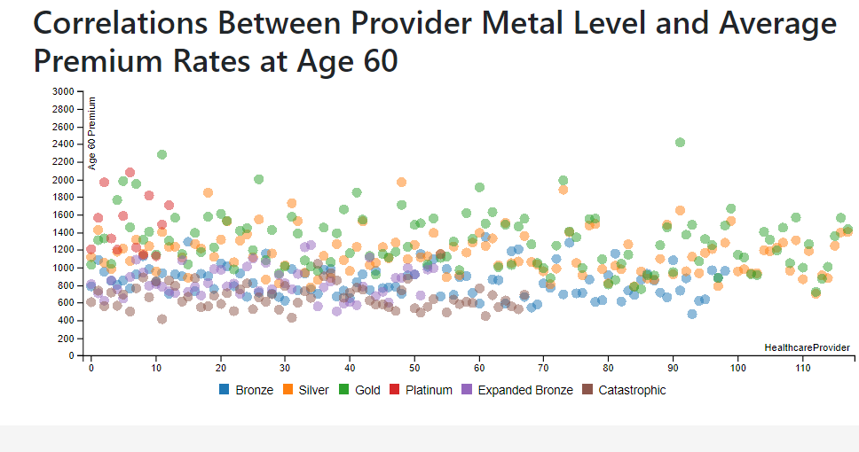
Metal Category
Bronze – Lowest Monthly Premium
Silver – Moderate Monthly Premium
Gold – High monthly Premium
Platinum – Highest monthly Premium
Expanded Bronze – a new Plan in 2018, an expansion of the Bronze plan
Catastrophic Plan – Affordability Exception

Slide 4
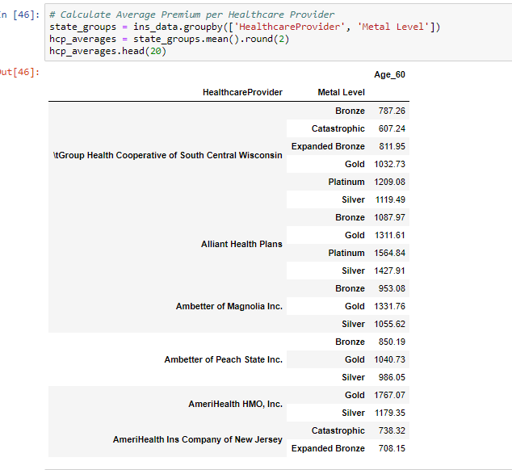
Data

Slide 5
In a Nutshell…
The team, observed that insurance plans have more addition is 2018.
Insurance plans began to declines starting from 2015 to 2018.
Insurance premiums rates are relatively high at Age 60.
Alaska has the highest average premium rates at $1409.77

Slide 6
GeoJSON
Pandas will read geoJSON files but changes the format.
It is much easier to manipulate geojson with libraries like geopands, which creates geoDFs that can be manipulated.
The geojson library has features which allow the convenient creation of geojson feature groups.

Slide 7
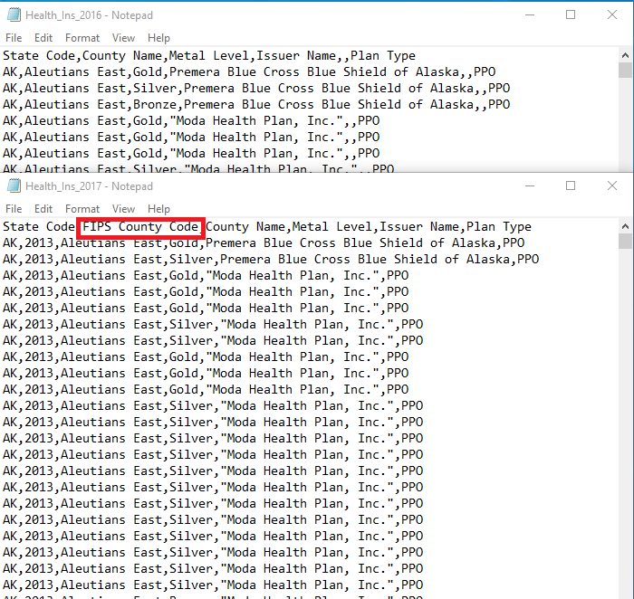
Inconsistent Data
The data we used had inconsistent data across years. We committed to using this data set without realizing how poor it was for years before 2016.
Incorrect spellings and missing data made it difficult to manipulate the data for some years.

